Slide 1

Predictive Learning from Data
LECTURE SET 6
Methods for Data Reduction and Dimensionality Reduction
Electrical and Computer Engineering

Slide 2
OUTLINE
Motivation for unsupervised learning
- Goals of modeling
- Overview of artificial neural networks
NN methods for unsupervised learning
Statistical methods for dim. reduction
Methods for multivariate data analysis
Summary and discussion

Slide 3
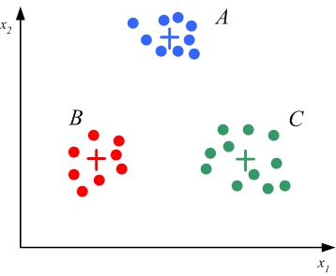
MOTIVATION
Recall from Lecture Set 2:
- unsupervised learning
- data reduction and dimensionality reduction
Example: Training data represented by 3 ‘centers’
H

Slide 4
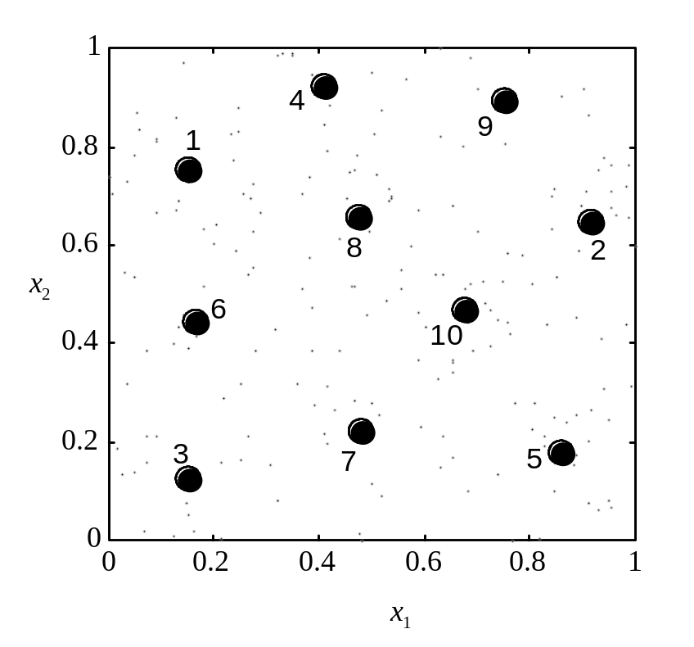
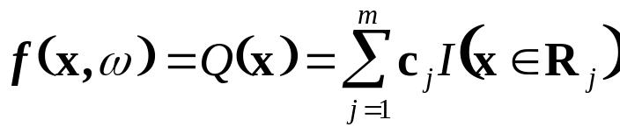


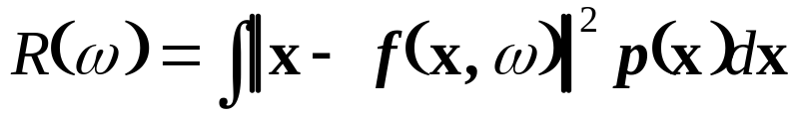
Two types of problems
1. Data reduction:
VQ + clustering
Vector Quantizer Q:
VQ setting: given n training samples
find the coordinates of m centers (prototypes) such that the total squared error distortion is minimized

Slide 5
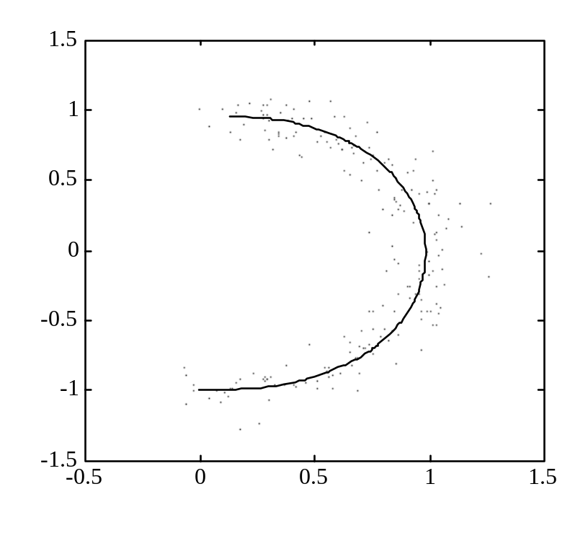
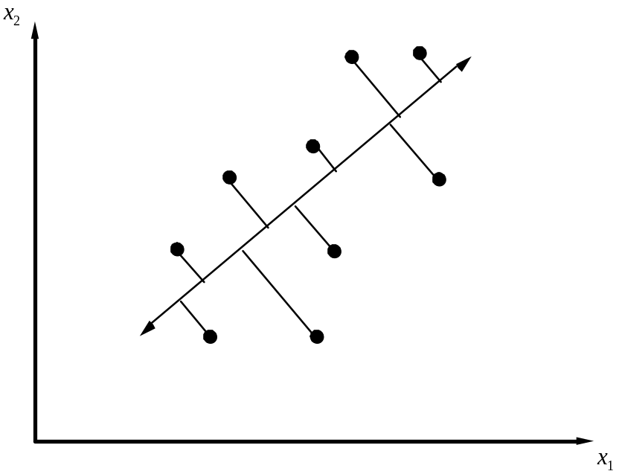
Dimensionality reduction:
linear nonlinear
Note: the goal is to estimate a mapping from d-dimensional input space (d=2) to low-dim. feature space (m=1)

Slide 6
Goals of Unsupervised Learning
Usually, not prediction
Understanding of multivariate data via
- data reduction (clustering)
- dimensionality reduction
Only input (x) samples are available
Preprocessing and feature selection preceding supervised learning
Methods originate from information theory, statistics, neural networks, sociology etc.
May be difficult to assess objectively

Slide 7
Overview of ANN’s
Huge interest in understanding the nature and mechanism of biological/ human learning
Biologists + psychologists do not adopt classical parametric statistical learning, because:
- parametric modeling is not biologically plausible
- biological info processing is clearly different from algorithmic models of computation
Mid 1980’s: growing interest in applying biologically inspired computational models to:
- developing computer models (of human brain)
- various engineering applications
→ New field Artificial Neural Networks (~1986 – 1989)
ANN’s represent nonlinear estimators implementing the ERM approach (usually squared-loss function)

Slide 8
Neural vs Algorithmic computation
Biological systems do not use principles of digital circuits
Digital Biological
Connectivity 1~10 ~10,000
Signal digital analog
Timing synchronous asynchronous
Signal propag. feedforward feedback
Redundancy no yes
Parallel proc. no yes
Learning no yes
Noise tolerance no yes

Slide 9
Neural vs Algorithmic computation
Computers excel at algorithmic tasks (well-posed mathematical problems)
Biological systems are superior to digital systems for ill-posed problems with noisy data
Example: object recognition [Hopfield, 1987]
PIGEON: ~ 10^^9 neurons, cycle time ~ 0.1 sec,
each neuron sends 2 bits to ~ 1K other neurons
→ 2x10^^13 bit operations per sec
OLD PC: ~ 10^^7 gates, cycle time 10^^-7, connectivity=2
→ 10x10^^14 bit operations per sec
Both have similar raw processing capability, but pigeons are better at recognition tasks

Slide 10
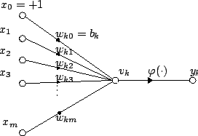
Neural terminology and artificial neurons
Some general descriptions of ANN’s:
http://www.doc.ic.ac.uk/~nd/surprise_96/journal/vol4/cs11/report.html
http://en.wikipedia.org/wiki/Neural_network
McCulloch-Pitts neuron (1943)
Threshold (indicator) function of weighted sum of inputs

Slide 11
Goals of ANN’s
Develop models of computation inspired by biological systems
Study computational capabilities of networks of interconnected neurons
Apply these models to real-life applications
Learning in NNs = modification (adaptation) of synaptic connections (weights) in response to external inputs (~ examples, data samples)

Slide 12
History of ANN
McCulloch-Pitts neuron
1949 Hebbian learning
1960’s Rosenblatt (perceptron), Widrow
60’s-70’s dominance of ‘hard’ AI
1980’s resurgence of interest (PDP group, MLP etc.)
1990’s connection to statistics/VC-theory
2000’s mature field/ lots of fragmentation
2010’s renewed interest ~ Deep Learning

Slide 13
Deep Learning
New marketing effort or smth different?
- several successful applications
- interest from the media, industry etc.
- lack of theoretical understanding
For critical & amusing discussion see:
Article in IEEE Spectrum on Big Data
http://spectrum.ieee.org/robotics/artificial-intelligence/machinelearning-maestro-michael-jordan-on-the-delusions-of-big-data-and-other-huge-engineering-efforts
And follow-up communications:
https://www.facebook.com/yann.lecun/posts/10152348155137143
https://amplab.cs.berkeley.edu/2014/10/22/big-data-hype-the-media-and-other-provocative-words-to-put-in-a-title/

Slide 14
Neural Network Learning Methods
Batch vs on-line learning (flow through)
- Algorithmic (statistical) approaches ~ batch
- Neural-network inspired methods ~ on-line
BUT the difference is only on technical level
Typical NN learning methods
- use on-line learning~ sequential estimation
- minimize squared loss function
- use various provisions for complexity control
Theoretical basis ~ stochastic approximation

Slide 15
OUTLINE
Motivation for unsupervised learning
NN methods for unsupervised learning
- Vector quantization and clustering
- Self-Organizing Maps (SOM)
- MLP for data compression
Statistical methods for dim. reduction
Methods for multivariate data analysis
Summary and discussion

Slide 16
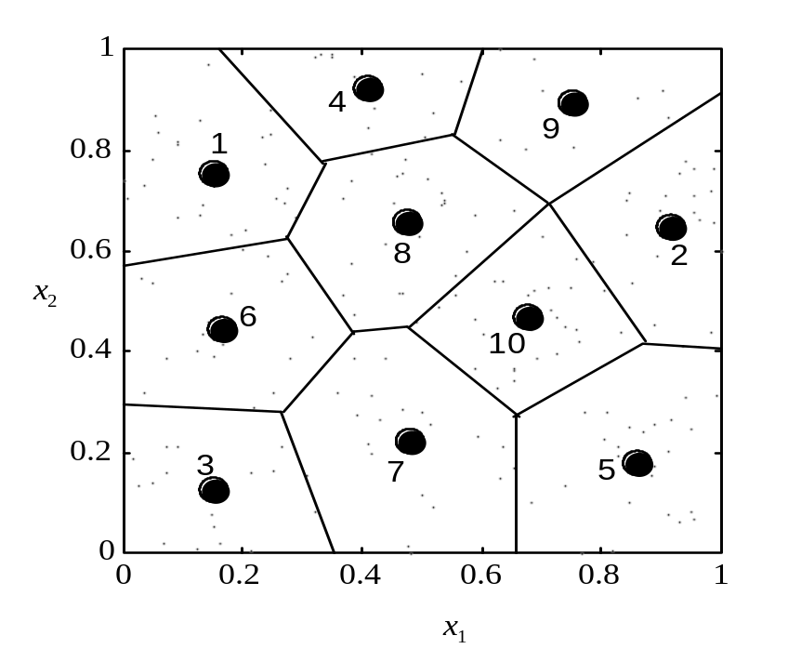
Vector Quantization and Clustering
Two complementary goals of VQ:
1. partition the input space into disjoint regions
2. find positions of units (coordinates of prototypes)
Note: optimal partitioning into regions is according to the nearest-neighbor rule (~ the Voronoi regions)

Slide 17




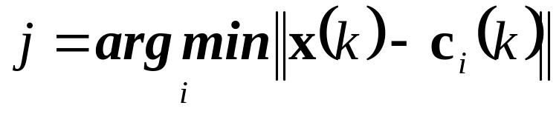
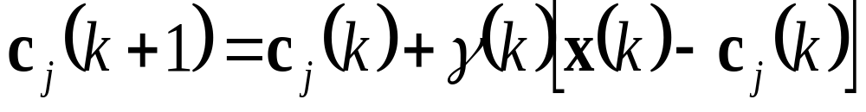
Flow Through Algorithm(GLA) for VQ
Given data points , loss function L (i.e., squared loss) and initial centers
Perform the following updates upon presentation of
1. Find the nearest center to the data point (the winning unit):
2. Update the winning unit coordinates (only) via
Increment k and iterate steps (1) – (2) above
Note: - the learning rate decreases with iteration number k
- biological interpretations of steps (1)-(2) exist

Slide 18

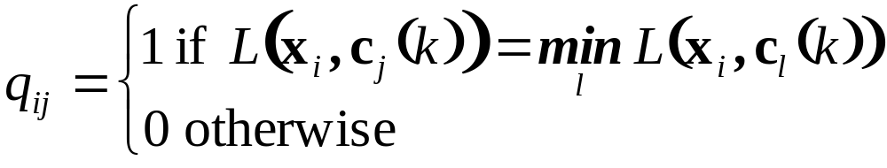
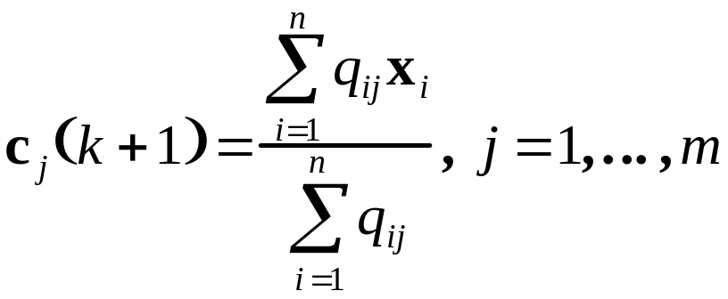
Batch Version of GLA
Iterate the following two steps
1. Partition the data (assign sample to unit j ) using the nearest neighbor rule. Partitioning matrix Q:
~ Projection of the data onto model space (units)
2. Update unit coordinates as centroids of the data:
~ Conditional expectation (averaging, smoothing)
‘conditional’ upon results of partitioning step (1)

Slide 19
Numeric Example for univariate data
Given data: {2,4,10,12,3,20,30,11,25}, set m=2
Initialization (random): c₁=3,c₂=4
Iteration 1
Projection: P₁={2,3} P₂={4,10,12,20,30,11,25}
Expectation (averaging): c₁=2.5, c₂=16
Iteration 2
Projection: P₁={2,3,4}, P₂={10,12,20,30,11,25} Expectation(averaging): c₁=3, c₂=18
Iteration 3
Projection: P₁={2,3,4,10},P₂={12,20,30,11,25} Expectation(averaging): c₁=4.75, c₂=19.6
Iteration 4
Projection: P₁={2,3,4,10,11,12}, P₂={20,30,25} Expectation(averaging): c₁=7, c₂=25
Stop as the algorithm is stabilized with these values

Slide 20
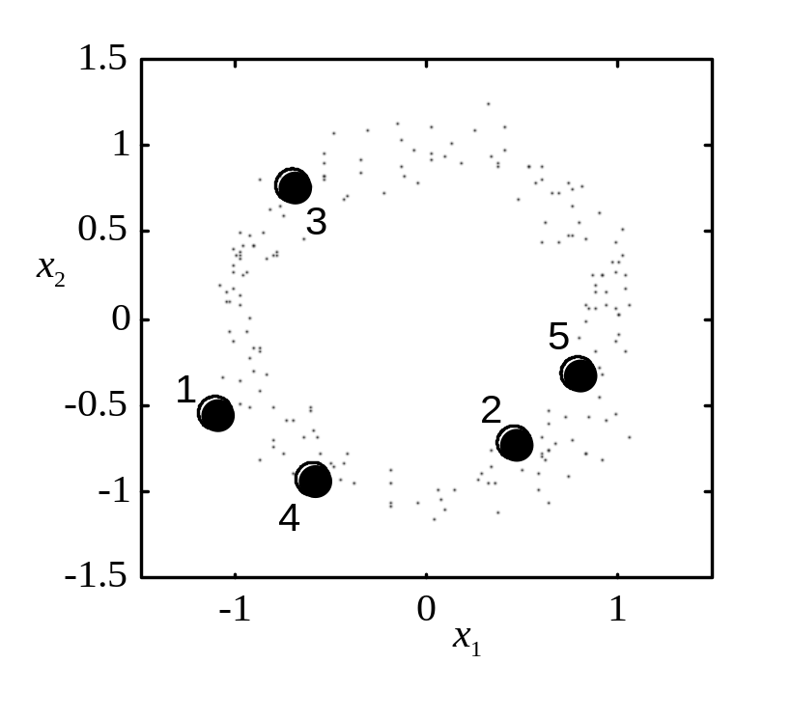
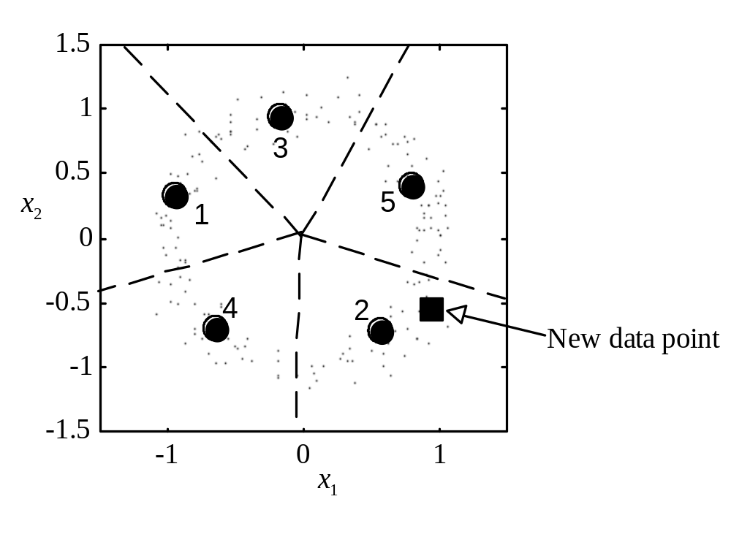
GLA Example 1
Modeling doughnut distribution using 5 units
(a) initialization (b) final position (of units)

Slide 21
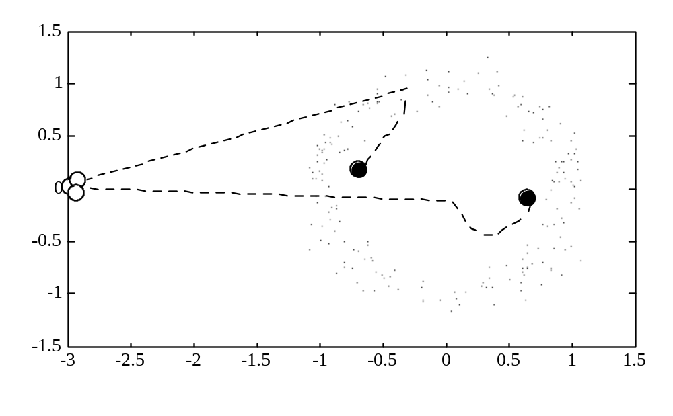
GLA Example 2
Modeling doughnut distribution using 3 units:
Bad initialization → poor local minimum

Slide 22
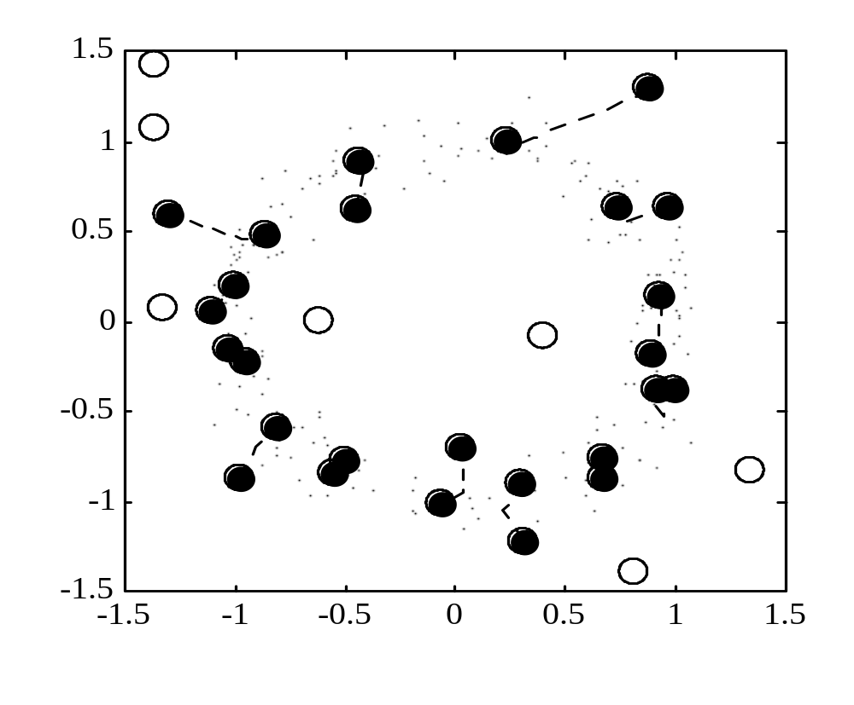
GLA Example 3
Modeling doughnut distribution using 20 units:
7 units were never moved by the GLA
→ the problem of unused units (dead units)

Slide 23
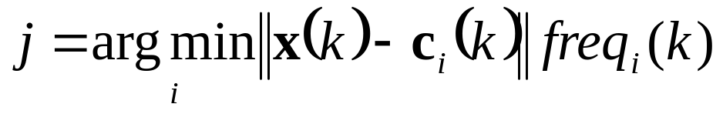
Avoiding local minima with GLA
Starting with many random initializations, and then choosing the best GLA solution
Conscience mechanism: forcing ‘dead’ units to participate in competition, by keeping the frequency count (of past winnings) for each unit,
i.e. for on-line version of GLA in Step 1
Self-Organizing Map: introduce topological relationship (map), thus forcing the neighbors of the winning unit to move towards the data.

Slide 24
Clustering methods
Clustering: separating a data set into several groups (clusters) according to some measure of similarity
Goals of clustering:
interpretation (of resulting clusters)
exploratory data analysis
preprocessing for supervised learning
often the goal is not formally stated
VQ-style methods (GLA) often used for clustering, aka k-means or c-means
Many other clustering methods as well

Slide 25
Clustering (cont’d)
Clustering: partition a set of n objects (samples) into K disjoint groups, based on some similarity measure. Assumptions:
- similarity ~ distance metric dist (i,j)
- usually K given a priori (but not always!)
Intuitive motivation:
similar objects into one cluster
dissimilar objects into different clusters
→ the goal is not formally stated
Similarity (distance) measure is critical
but usually hard to define (~ feature selection). Distance may need to be defined for different types of input variables.

Slide 26
Overview of Clustering Methods
Hierarchical Clustering:
tree-structured clusters
Partitional methods:
typically variations of GLA known as k-means or c-means, where clusters can merge and split dynamically
Partitional methods can be divided into
- crisp clustering ~ each sample belongs to only one cluster
- fuzzy clustering ~ each sample may belong to several clusters

Slide 27
Applications of clustering
Marketing:
explore customers data to identify buying patterns for targeted marketing (Amazon.com)
Economic data:
identify similarity between different countries, states, regions, companies, mutual funds etc.
Web data:
cluster web pages or web users to discover groups of similar access patterns
Etc., etc.

Slide 28
K-means clustering
Given a data set of n samples and the value of k:
Step 0: (arbitrarily) initialize cluster centers
Step 1: assign each data point (object) to the cluster with the closest cluster center
Step 2: calculate the mean (centroid) of data points in each cluster as estimated cluster centers
Iterate steps 1 and 2 until the cluster membership is stabilized

Slide 29



The K-Means Clustering Method
Example
10
10
9
9
8
8
7
7
6
6
5
5
4
Assign each objects to most similar center
Update the cluster means
4
3
3
2
2
1
1
0
0
0
1
2
3
4
5
6
7
8
9
10
0
1
2
3
4
5
6
7
8
9
10
reassign
K=2
Arbitrarily choose K points as initial cluster centers
reassign
Update the cluster means

Slide 30
Self-Organizing Maps
History and biological motivation
Brain changes its internal structure to reflect life experiences → interaction with environment is critical at early stages of brain development (first 2-3 years of life)
Existence of various regions (maps) in the brain
How these maps may be formed?
i.e. information-processing model leading to map formation
T. Kohonen (early 1980’s) proposed SOM
Original flow-through SOM version reminds VQ-style algorithm

Slide 31

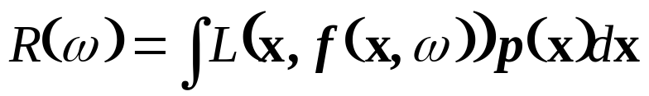

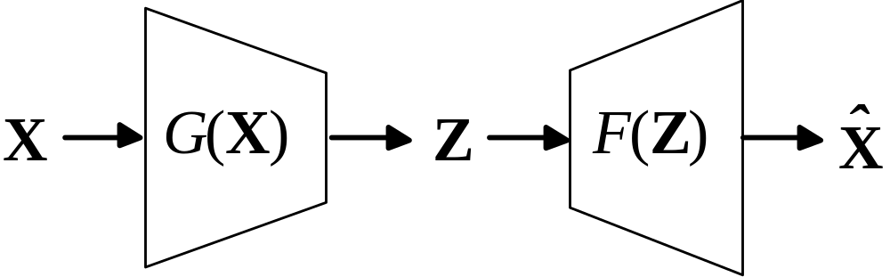
SOM and Dimensionality Reduction
Dimensionality reduction as information bottleneck
( = data reduction )
The goal of learning is to find a mapping
minimizing prediction risk
Mapping provides low-dimensional encoding of original high-dimensional data (it is implemented by SOM)

Slide 32
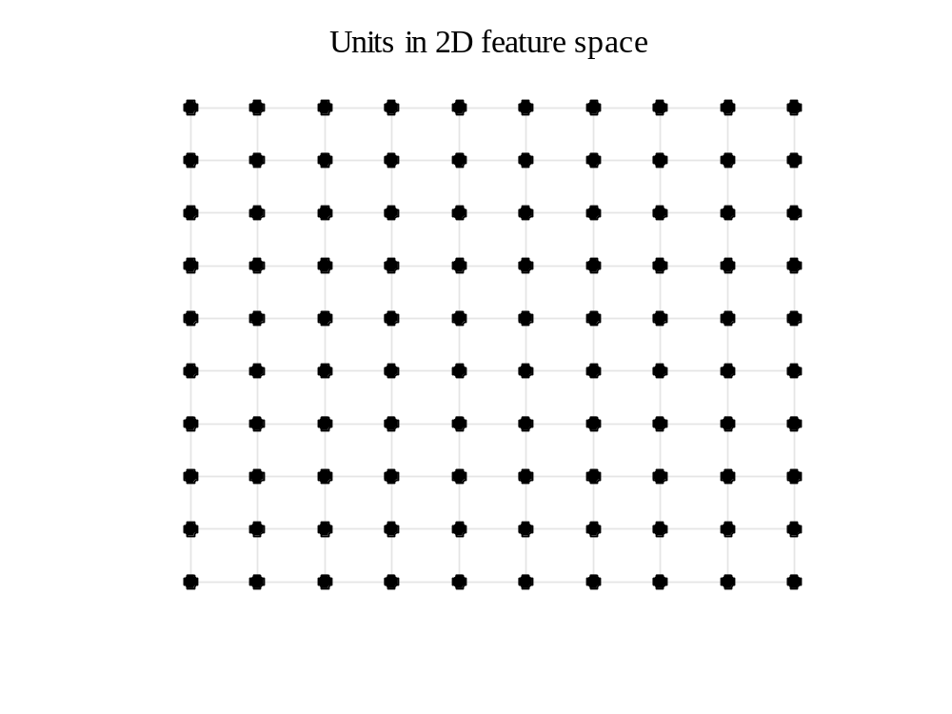
Self-Organizing Map
Discretization of 2D space via 10x10 map. In this discrete
space, distance relations exist between all pairs of units. Distance relation ~ map topology

Slide 33
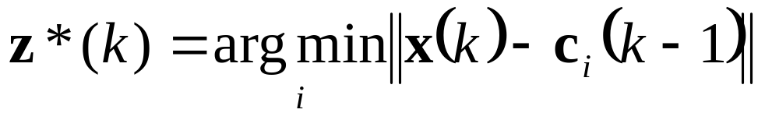
SOM Algorithm (flow through)
Given data points , distance metric in the input space (~ Euclidean), map topology (in z-space), initial position of units (in x-space)
Perform the following updates upon presentation of
1. Find the nearest center to the data point (the winning unit):
2. Update all units around the winning unit via
Increment k, decrease the learning rate and the neighborhood width, and repeat steps (1) – (2) above

Slide 34
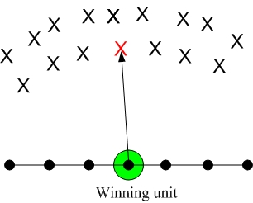
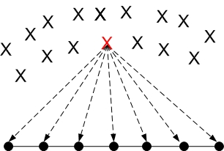
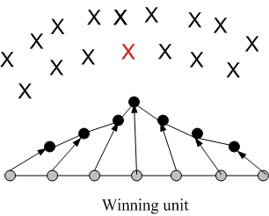
SOM example (1-st iteration)
Step 1:
Step 2:

Slide 35
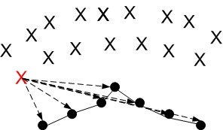
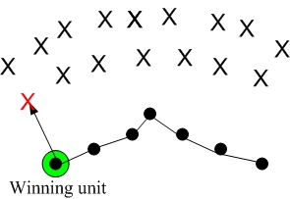
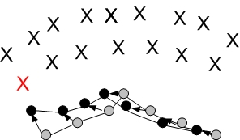
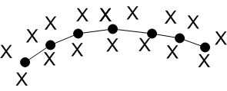
SOM example (next iteration)
Step 1:
Step 2:
Final map

Slide 36
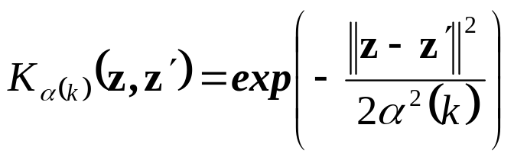
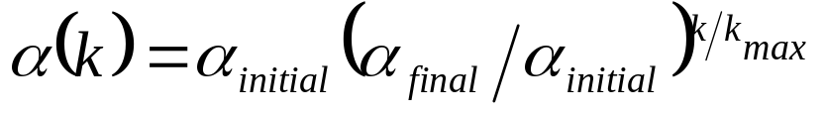
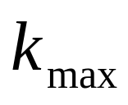
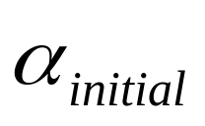
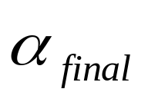
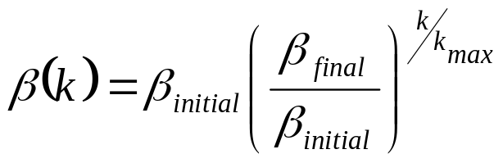
Hyper-parameters of SOM
SOM performance depends on parameters (~ user-defined):
Map dimension and topology (usually 1D or 2D)
Number of SOM units ~ quantization level (of z-space)
Neighborhood function ~ rectangular or gaussian (not important)
Neighborhood width decrease schedule (important), i.e. exponential decrease for Gaussian
with user defined:
Also linear decrease of neighborhood width
Learning rate schedule (important)
(also linear decrease)
Note: learning rate and neighborhood decrease should be set jointly

Slide 37
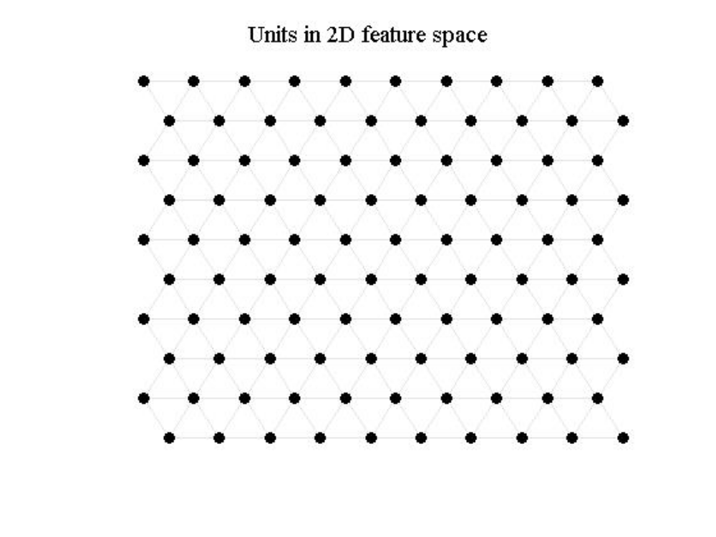
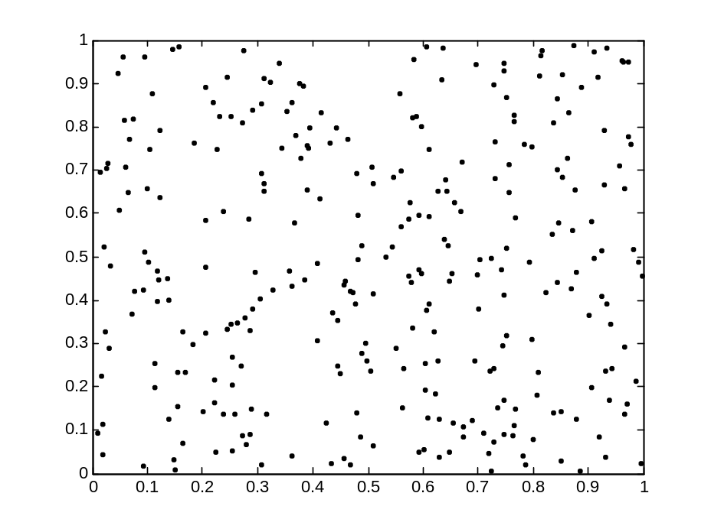

Modeling uniform distribution via SOM
(a) 300 random samples (b) 10X10 map
SOM neighborhood: Gaussian
Learning rate: linear decrease

Slide 38
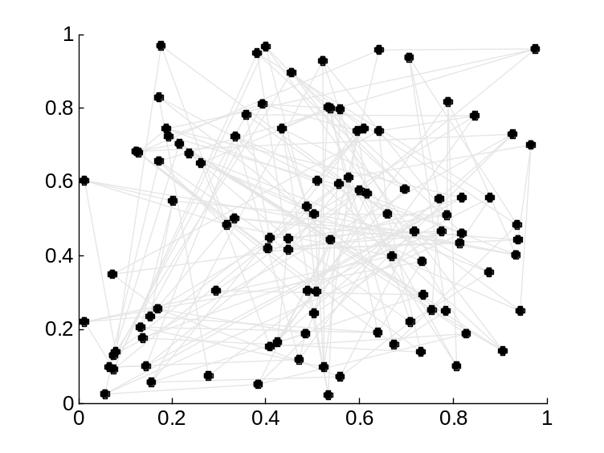
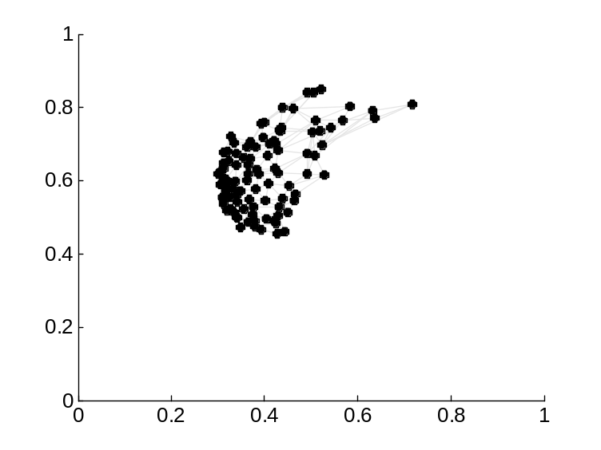
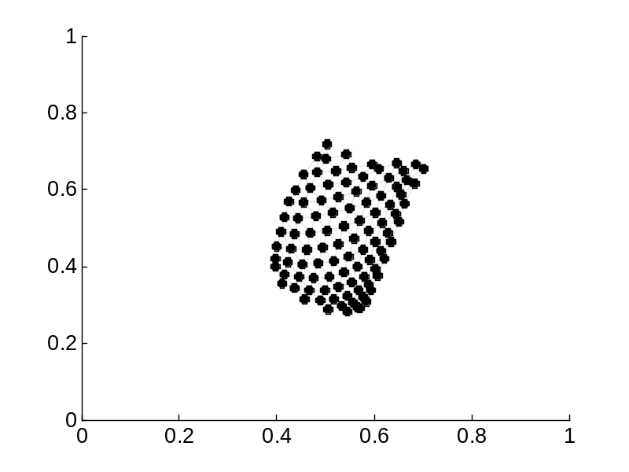
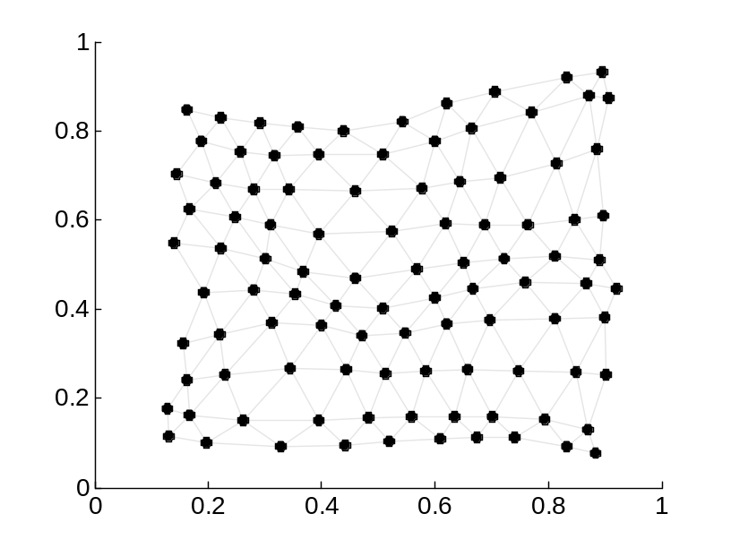
Position of SOM units: (a) initial, (b) after 50 iterations, (c) after 100 iterations, (d) after 10,000 iterations

Slide 39
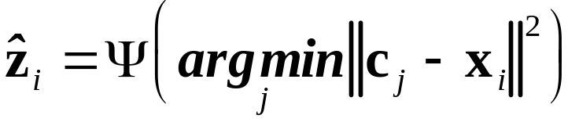
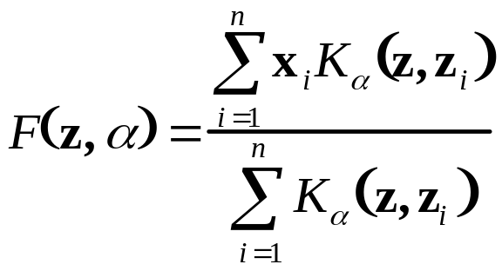

Batch SOM (similar to Batch GLA)
Given data points , distance metric (i.e., Euclidian), map topology and initial centers
Iterate the following two steps
1. Project the data onto map space (discretized Z-space) using the nearest distance rule:
Encoder G(x):
2. Update unit coordinates = kernel smoothing (in Z-space):
Decrease the neighborhood, and iterate.
NOTE: solution is (usually) insensitive to poor initialization

Slide 40
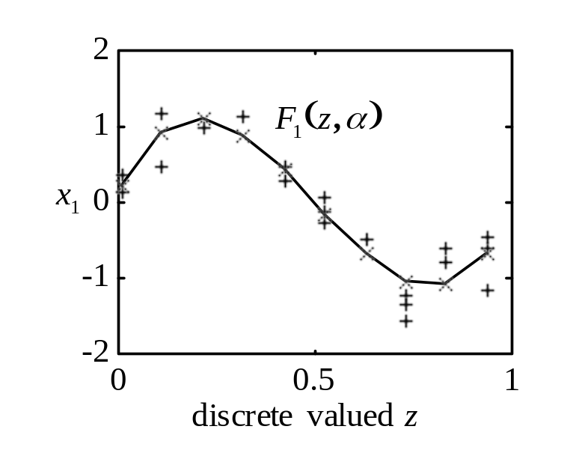
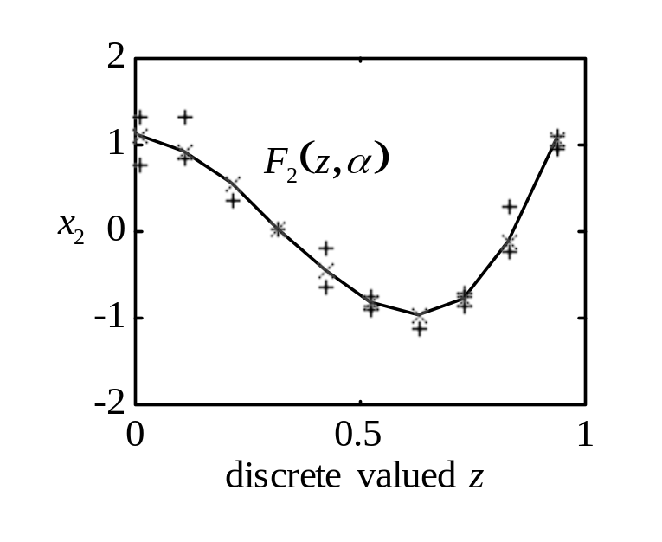
Example: one iteration of batch SOM
Projection step
Smoothing
Discretization: j z
1.5
1 0.0
2 0.1
3 0.2
4 0.3
5 0.4
6 0.5
7 0.6
8 0.7
9 0.8
10 0.9
c
10
c
1
c
1
2
c
3
0.5
x
c
4
2
0
c
9
-0.5
c
c
c
5
8
c
7
6
-1
-1.5
-2
-1.5
-1
-0.5
0
0.5
1
1.5
x
1

Slide 41
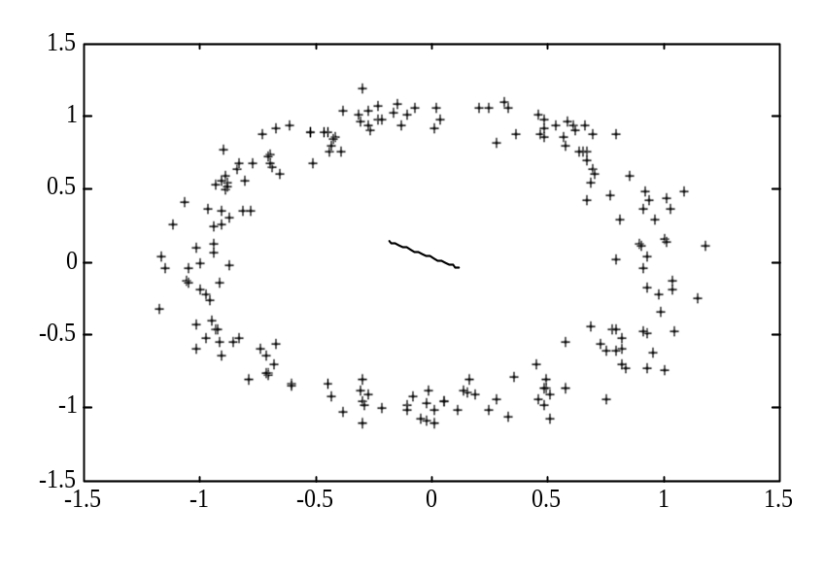
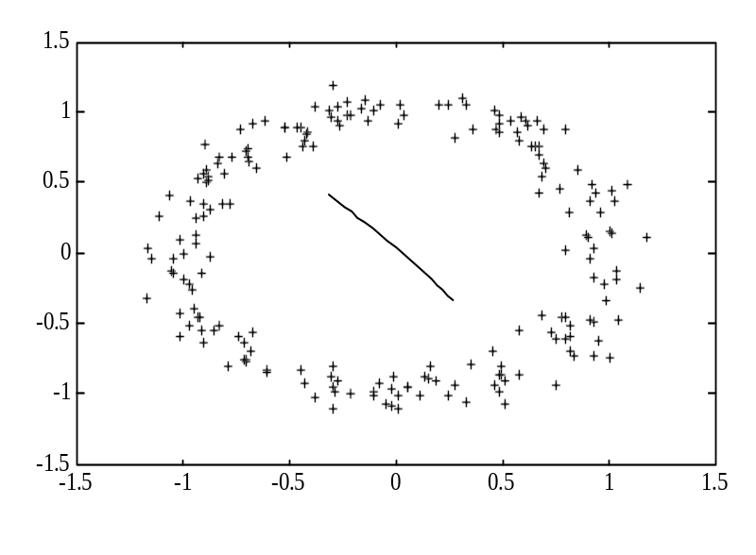
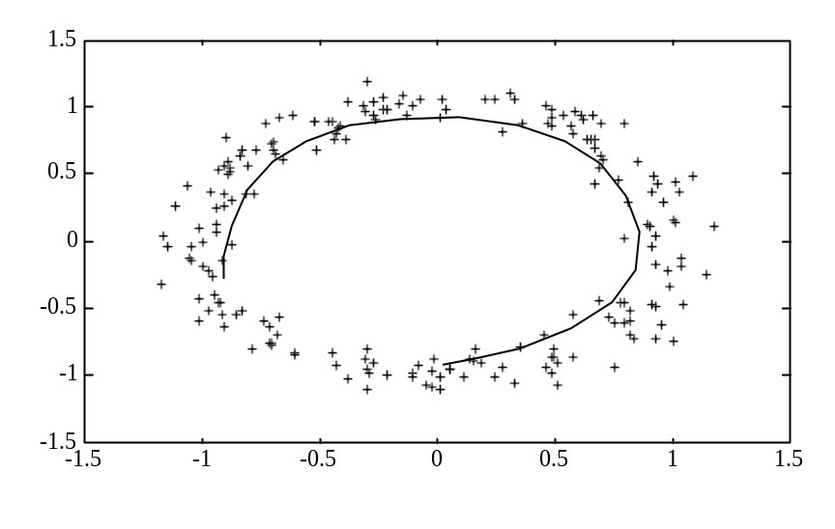
Example: effect of the final neighborhood width
90% 50%
10%

Slide 42
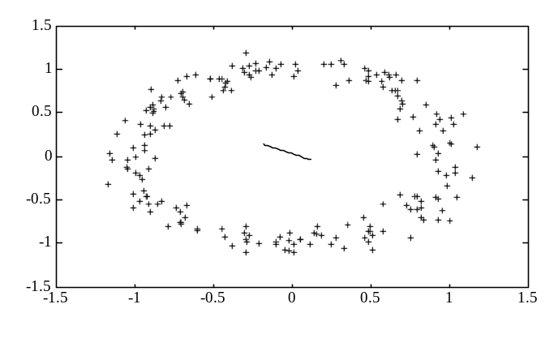
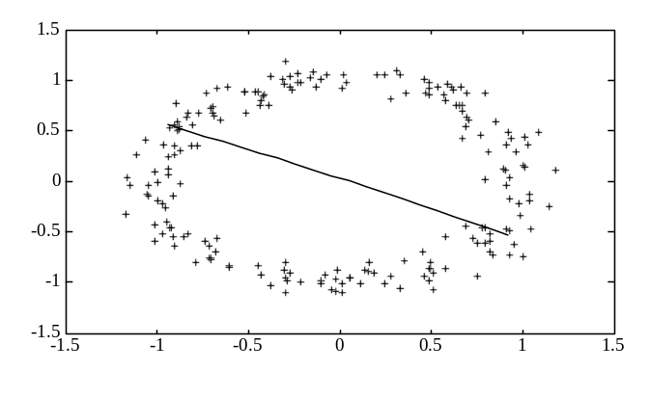

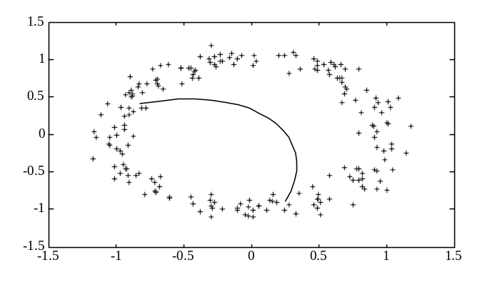
Statistical Interpretation of SOM
New approach to dimensionality reduction: kernel smoothing in a map space
Local averaging vs local linear smoothing. Local Average Local Linear
90%
50%

Slide 43
Practical Issues for SOM
Pre-scaling of inputs, usually to [0, 1] range. Why?
Map topology: usually 1D or 2D
Number of map units (per dimension)
Learning rate schedule (for on-line version)
Neighborhood type and schedule:
Initial size (~1), final size
Final neighborhood size and the number of units determine model complexity.

Slide 44
SOM Similarity Ranking of US States
Each state ~ a multivariate sample of
several socio-economic inputs for 2000:
- OBE obesity index (see Table 1)
- EL election results (EL=0~Democrat, =1 ~ Republican)-see Table 1
- MI median income (see Table 2)
- NAEP score ~ national assessment of educational progress
- IQ score
Each input pre-scaled to (0,1) range
Model using 1D SOM with 9 units

Slide 45
TABLE 1
STATE % Obese 2000Election
Hawaii 17 D
Wisconsin 22 D
Colorado 17 R
Nevada 22 R
Connecticut 18 D
Alaska 23 R
…………………………..

Slide 46
TABLE 2
STATE MI NAEP IQ
Massachusets $50,587 257 111
New Hampshire $53,549 257 102
Vermont $41,929 256 103
Minnesota $54,939 256 113
…………………………..

Slide 47

SOM Modeling Result 1 (by Feng Cai)

Slide 48
SOM Modeling Result 1
Out of 9 units total:
- units 1-3 ~ Democratic states
- unit 4 – no states (?)
- units 5-9 ~ Republican states
Explanation:
election input has two extreme values (0/1) and tends to dominate in distance calculation

Slide 49

SOM Modeling Result 2: no voting input

Slide 50
SOM Applications and Variations
Main web site: http://www.cis.hut.fi/research/som-research
Public domain SW
Numerous Applications
Marketing surveys/ segmentation
Financial/ stock market data
Text data / document map – WEBSOM
Image data / picture map - PicSOM
see HUT web site
Semantic maps ~ category formation http://link.springer.com/article/10.1007/BF00203171
SOM for Traveling Salesman Problem

Slide 51


Tree-structured SOM
Fixed SOM topology provides poor modeling for structured distributions:

Slide 52


Minimum Spanning Tree SOM
Define SOM topology adaptively during each iteration of SOM algorithm
Minimum Spanning Tree (MST) topology ~ according to distance between units (in the input space)
→ Topological distance ~ number of hops in MST

Slide 53

Example of using MST SOM
Modeling cross distribution
MST topology vs. fixed 2D grid map

Slide 54



Application: skeletonization of images Singh at al, Self-organizing maps for skeletonization of sparse shapes, IEEE TNN, 2000
Skeletonization Problem:
Easy problem if image boundaries are known
Skeletonization of noisy images is hard
Application of MST SOM: robust with respect to noise

Slide 55


Modification of MST to represent loops
Postprocessing: in the trained SOM identify a pair of units close in the input space but far in the map space (more than 3 hops apart). Connect these units.
Example: Percentage indicates the proportion of data used for approximation from original image.

Slide 56
Clustering of European Languages
Background historical linguistics studies relatedness btwn languages based on
phonology, morphology, syntax and lexicon
Difficulty of the problem: due to evolving nature of human languages and globalization.
Hypothesis: similarity based on analysis of a small ‘stable’ word set.
See glottochronology, Swadesh list, at
http://en.wikipedia.org/wiki/Glottochronology

Slide 57
SOM for clustering European languages
Modeling approach: language ~ 10 word set.
Assuming words in different languages are encoded in the same alphabet, it is possible to perform clustering using some distance measure.
Issues:
selection of stable word set
data encoding + distance metric
Stable word set: numbers 1 to 10
Data encoding: Latin alphabet, use 3 first letters (in each word)

Slide 58

Numbers word set in 18 European languages
Each language is a feature vector encoding 10 words

Slide 59

Data Encoding
Word ~ feature vector encoding 3 first letters
Alphabet ~ 26 letters + 1 symbol ‘BLANK’
vector encoding:
For example, ONE : ‘O’~14 ‘N’~15 ‘E’~05

Slide 60

Word Encoding (cont’d)
Word → 27-dimensional feature vector
Encoding is insensitive to order (of 3 letters)
Encoding of 10-word set: concatenate feature vectors of all words: ‘one’ + ‘two’ + …+ ‘ten’
→ word set encoded as vector of dim. [1 X 270]

Slide 61

SOM Modeling Approach
2-Dimensional SOM (Batch Algorithm)
      Number of Knots per dimension=4
      Initial Neighborhood =1 Final Neighborhood = 0.15
      Total Number of Iterations= 70

Slide 62

SOM for Supervised Learning
How to apply SOM
to regression problem?
CTM Approach:
Given training data (x,y) perform
Dimensionality reduction x→z
(Apply SOM to x-values of training data)
2. Apply kernel regression to estimate y=f(z) at discrete points in z-space

Slide 63

Constrained Topological Mapping: search for nearest unit (winning unit) in x-space

Slide 64
MLP for data compression
Recall general setting for data compression and dimensionality reduction
How to implement it via MLP?
Can we use single hidden layer MLP?

Slide 65

Need multiple hidden layers to implement nonlinear dimensionality reduction:
both F and G are
nonlinear
Many problems
(with implementation)

Slide 66
OUTLINE
Motivation for unsupervised learning
NN methods for unsupervised learning
Statistical methods for dimensionality reduction
- Principal components (PCA)
- Principal curves
- Multidimensional scaling (MDS)
Methods for multivariate data analysis
Summary and discussion

Slide 67
Dimensionality reduction
Recall dimensionality reduction ~ estimation of two mappings G(x) and F(z)
The goal of learning is to find a mapping
minimizing prediction risk
Two approaches: linear G(x) or nonlinear G(x)

Slide 68




Linear Principal Components
Linear Mapping: training data is modeled as a linear combination of orthonormal vectors (called PC’s)
where V is a dxm matrix with orthonormal columns
The projection matrix V minimizes

Slide 69

For linear mappings, PCA has optimal properties:
Best low-dimensional approximation of the data (min empirical risk MSE)
Principal components provide maximum variance of the data in a low-dim. projection
Best possible solution for normal distributions.

Slide 70




Principal Curves
Principal Curve: Generalization of the first linear PC i.e., the curve that passes through
the ‘middle’ of the data
The Principal Curve (manifold) is a vector-valued function that minimizes the empirical risk
Subject to smoothness constraint on

Slide 71



Self Consistency Conditions
The point of the curve ~
the mean of all points that
‘project’ on the curve
Necessary Conditions for Optimality
Encoder Mapping
Decoder mapping (Smoothing/ conditional expectation)

Slide 72




Algorithm for estimating PC (manifold)
Given data points , distance metric, and initial estimate of d-valued function iterate the following steps
Iterate the following two steps
Projection for each data point, find its closest projected point on the curve (manifold)
Conditional expectation = kernel smoothing
~ use as training data for multiple-output regression problem. The resulting estimates are components of the d-dimensional function describing principal curve
Increase flexibility: decrease the smoothing parameter of the regression estimator

Slide 73






Example: one iteration of principal curve algorithm
20 samples generated according to
1.5
z
0
1
0.5
Projection step
x
2
0
Data points projected on the curve to estimate
-0.5
F
(
z
)
-1
-1.5
-2
-1.5
-1
-0.5
0
0.5
1
1.5
Smoothing step
Estimates
describe principal
curve in a parametric
form
x
1

Slide 74





Multidimensional Scaling (MDS)
Mapping n input samples onto a set of points in a low-dim. space that preserves the interpoint distances of inputs and
MDS minimizes the stress function
Note: MDS uses only interpoint distances, and does not provide explicit mapping X→Z

Slide 75


Example

Slide 76
Norfolk
50
Roanoke
Richmond
0
Charlottesville
z₂
-50
-100
WashingtonDC
-100
-50
0
z₁
50
100
150

Slide 77
MDS for clustering European languages
Modeling approach: language ~ 10 word set.
Assuming words in different languages are encoded in the same alphabet, it is possible to perform clustering using some distance measure.
Issues:
selection of stable word set
data encoding + distance metric
Stable word set: numbers 1 to 10
Data encoding: Latin alphabet, use 3 first letters (in each word) – the same as was used for SOM → 270-dimensional vector

Slide 78

MDS Modeling Approach:
- calculate interpoint distances (Euclidean) btwn feature vectors
- map data points onto 2D space using software package Past http://folk.uio.no/ohammer/past/

Slide 79

MDS Modeling Approach: Map 270-dimensional data samples onto 2D space while preserving interpoint distances

Slide 80
OUTLINE
Motivation for unsupervised learning
NN methods for unsupervised learning
Statistical methods for dimensionality reduction
Methods for multivariate data analysis
Summary and discussion

Slide 81



Methods for multivariate data analysis
Motivation: in many applications, observed (correlated) variables are assumed to depend on a small number of hidden or latent variables
The goal is to model the system as
where z is a set of factors of dim. m
Note: identifiability issue, the setting is not predictive
Approaches: PCA, Factor Analysis, ICA

Slide 82


Factor Analysis
Motivation from psychology, aptitude tests
Assumed model
where x, z and u are column vectors.
z ~ common factor(s), u ~ unique factors
Assumptions:
Gaussian x, z and u (zero-mean)
Uncorrelated z and u
Unique factors ~ noise for each input variable (not seen in other variables)

Slide 83


Example: Measuring intelligence
Aptitude tests: similarities, arithmetic, vocabulary, comprehension. Correlation btwn test scores
FA result

Slide 84
Factor Analysis (cont’d)
FA vs PCA:
- FA breaks down the covariance into two parts: common and unique factors
- if unique factors are small (zero variance) then FA ~ PCA
FA is designed for descriptive setting but used to infer causality (in social studies)
However, it is dangerous to infer causality from correlations in the data

Slide 85
OUTLINE
Motivation for unsupervised learning
NN methods for unsupervised learning
Statistical methods for dimensionality reduction
Methods for multivariate data analysis
Summary and discussion

Slide 86
Summary and Discussion
Methods originate from: statistics, neural networks, signal processing, data mining, psychology etc.
Methods pursue different goals:
- data reduction, dimensionality reduction, data understanding, feature extraction
Unsupervised learning may be combined with supervised-learning (if there exist many unlabeled samples)
SOM ~ new approach to dim. reduction

